Slide 1
Experimentally Informed Site-Specific Substitution Models Substantially Deepen Divergence Estimates
Notes:
Color scheme
black = "black”
blue = "#439FC3”
green = "#397262”
orange = "#F9842A”
red = "#B52A24”
pink = "#CC79A7"

Slide 2
Notes
I took all of the raw figures from the `plot.ipynb` in `analysis/HA_Trees/`

Slide 3
MAIN FIGURES

Slide 4
Decay to stationary state

Slide 5
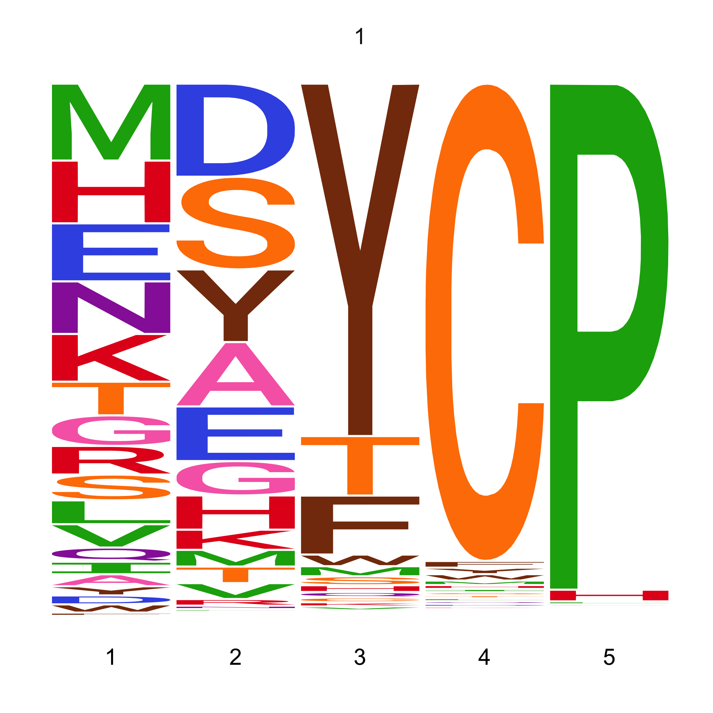
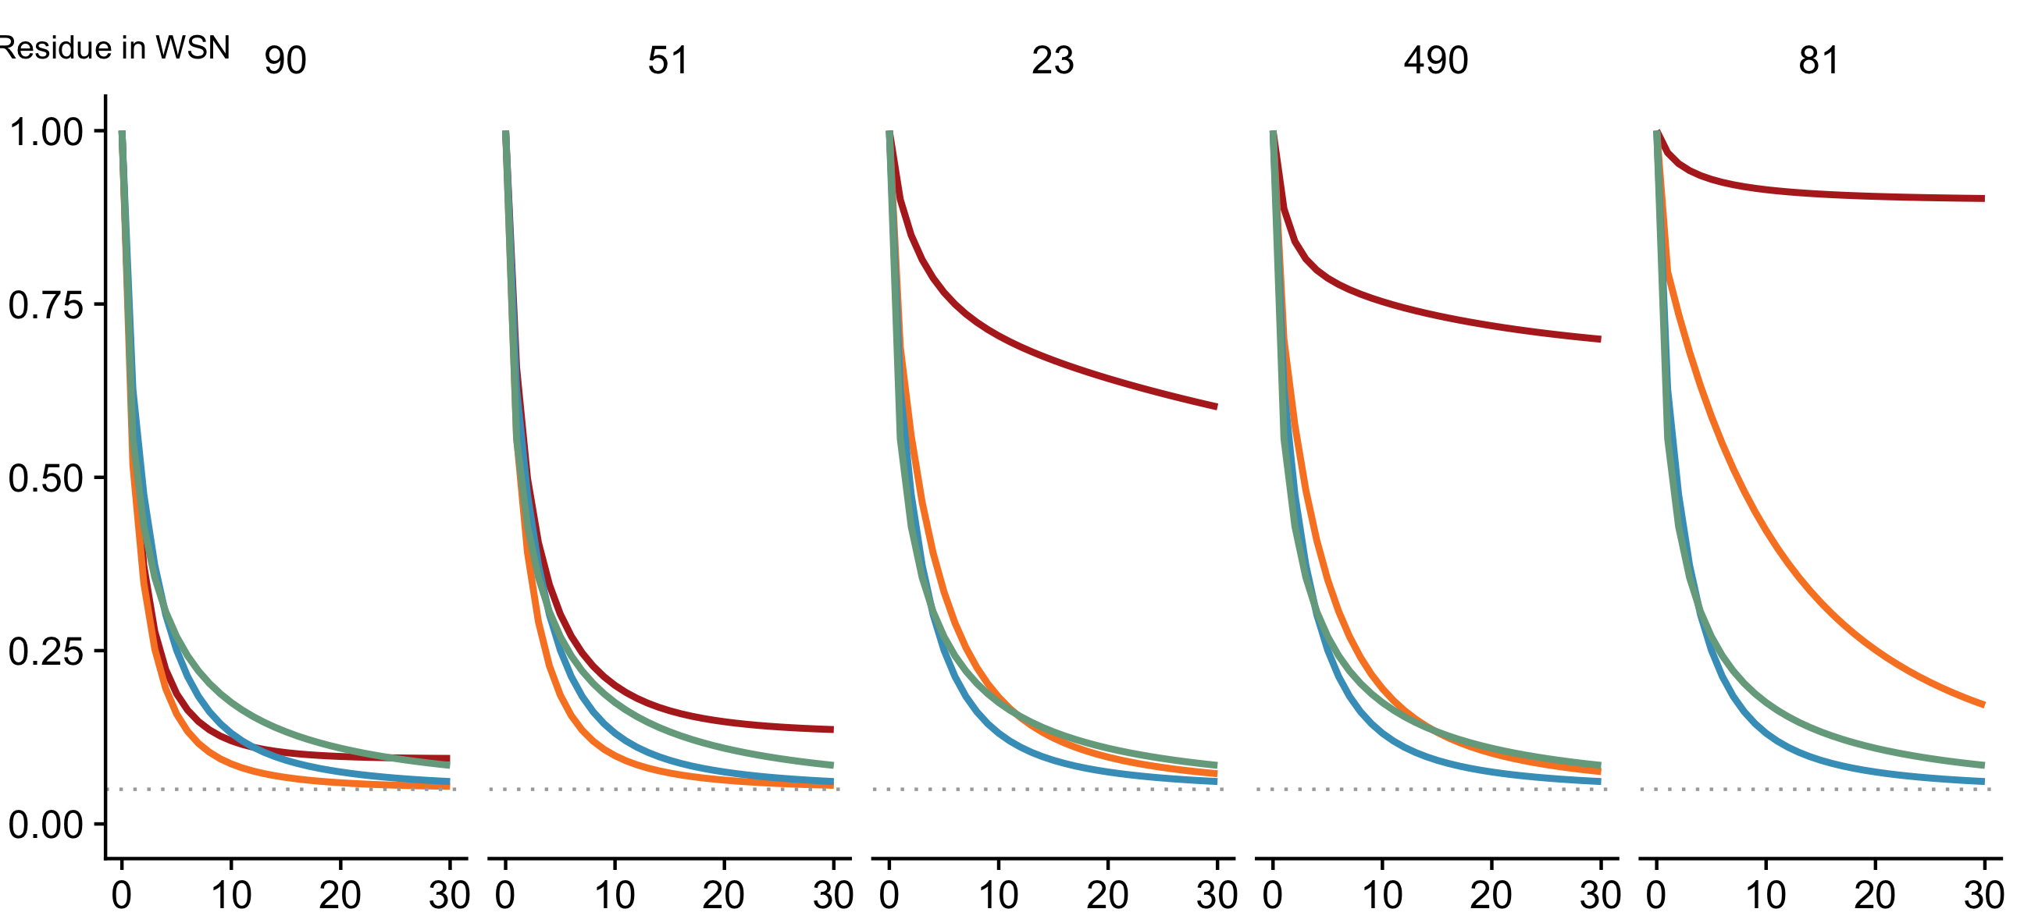
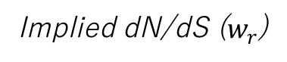
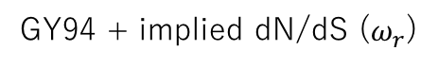
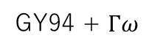
A
B
Site in HA
90
51
23
490
81
Implied dN/dS ($w_{r}$)
0.80
0.61
0.27
0.18
0.06
Expected pairwise amino-acid identity at a site
Branch length (codon substitutions per site)
Model
ExpCM
GY94
GY94 + $Γω$
GY94 + implied dN/dS ($ω_{r}$)
Notes:
Note to self: This plot is the H1 only tree paramters.

Slide 6
Model feature comparison

Slide 7
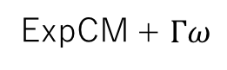
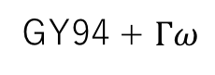
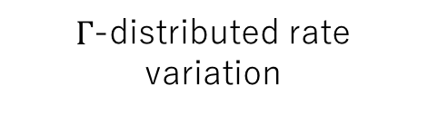
Site-specific preferences
$Γ$-distributed rate variation
GY94
GY94 + $Γω$
ExpCM
ExpCM + $Γω$

Slide 8
Workflow

Slide 9
Model #2
Base topology
Model #1 vs. Model #2
Branch length optimized by model #2
Branch length optimized by model #1
Model #1

Slide 10
Simulations

Slide 11
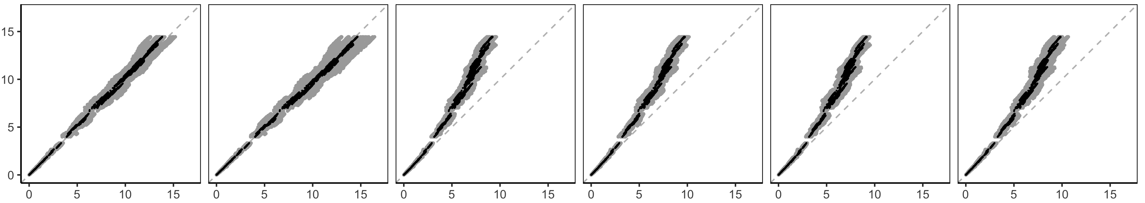
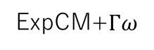
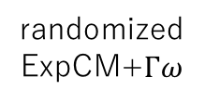
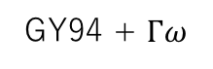
randomized
ExpCM
randomized
ExpCM+$Γω$
ExpCM
ExpCM+$Γω$
GY94
GY94 + $Γω$
Actual branch length
Branch length optimized by the model

Slide 12
Model Comparison Trees

Slide 13
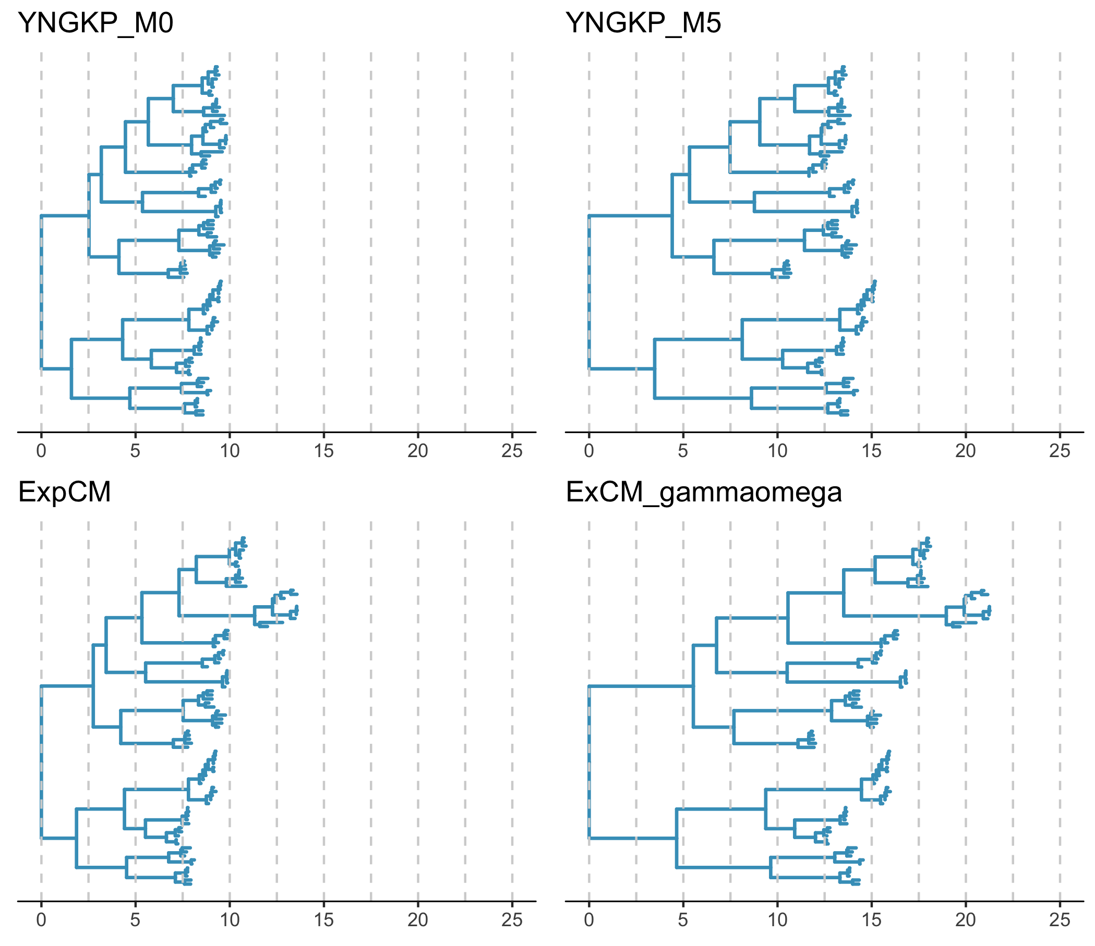
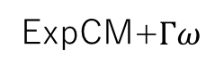
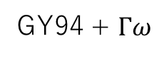
GY94
GY94 + $Γω$
ExpCM
ExpCM+$Γω$
Normalized branch length

Slide 14
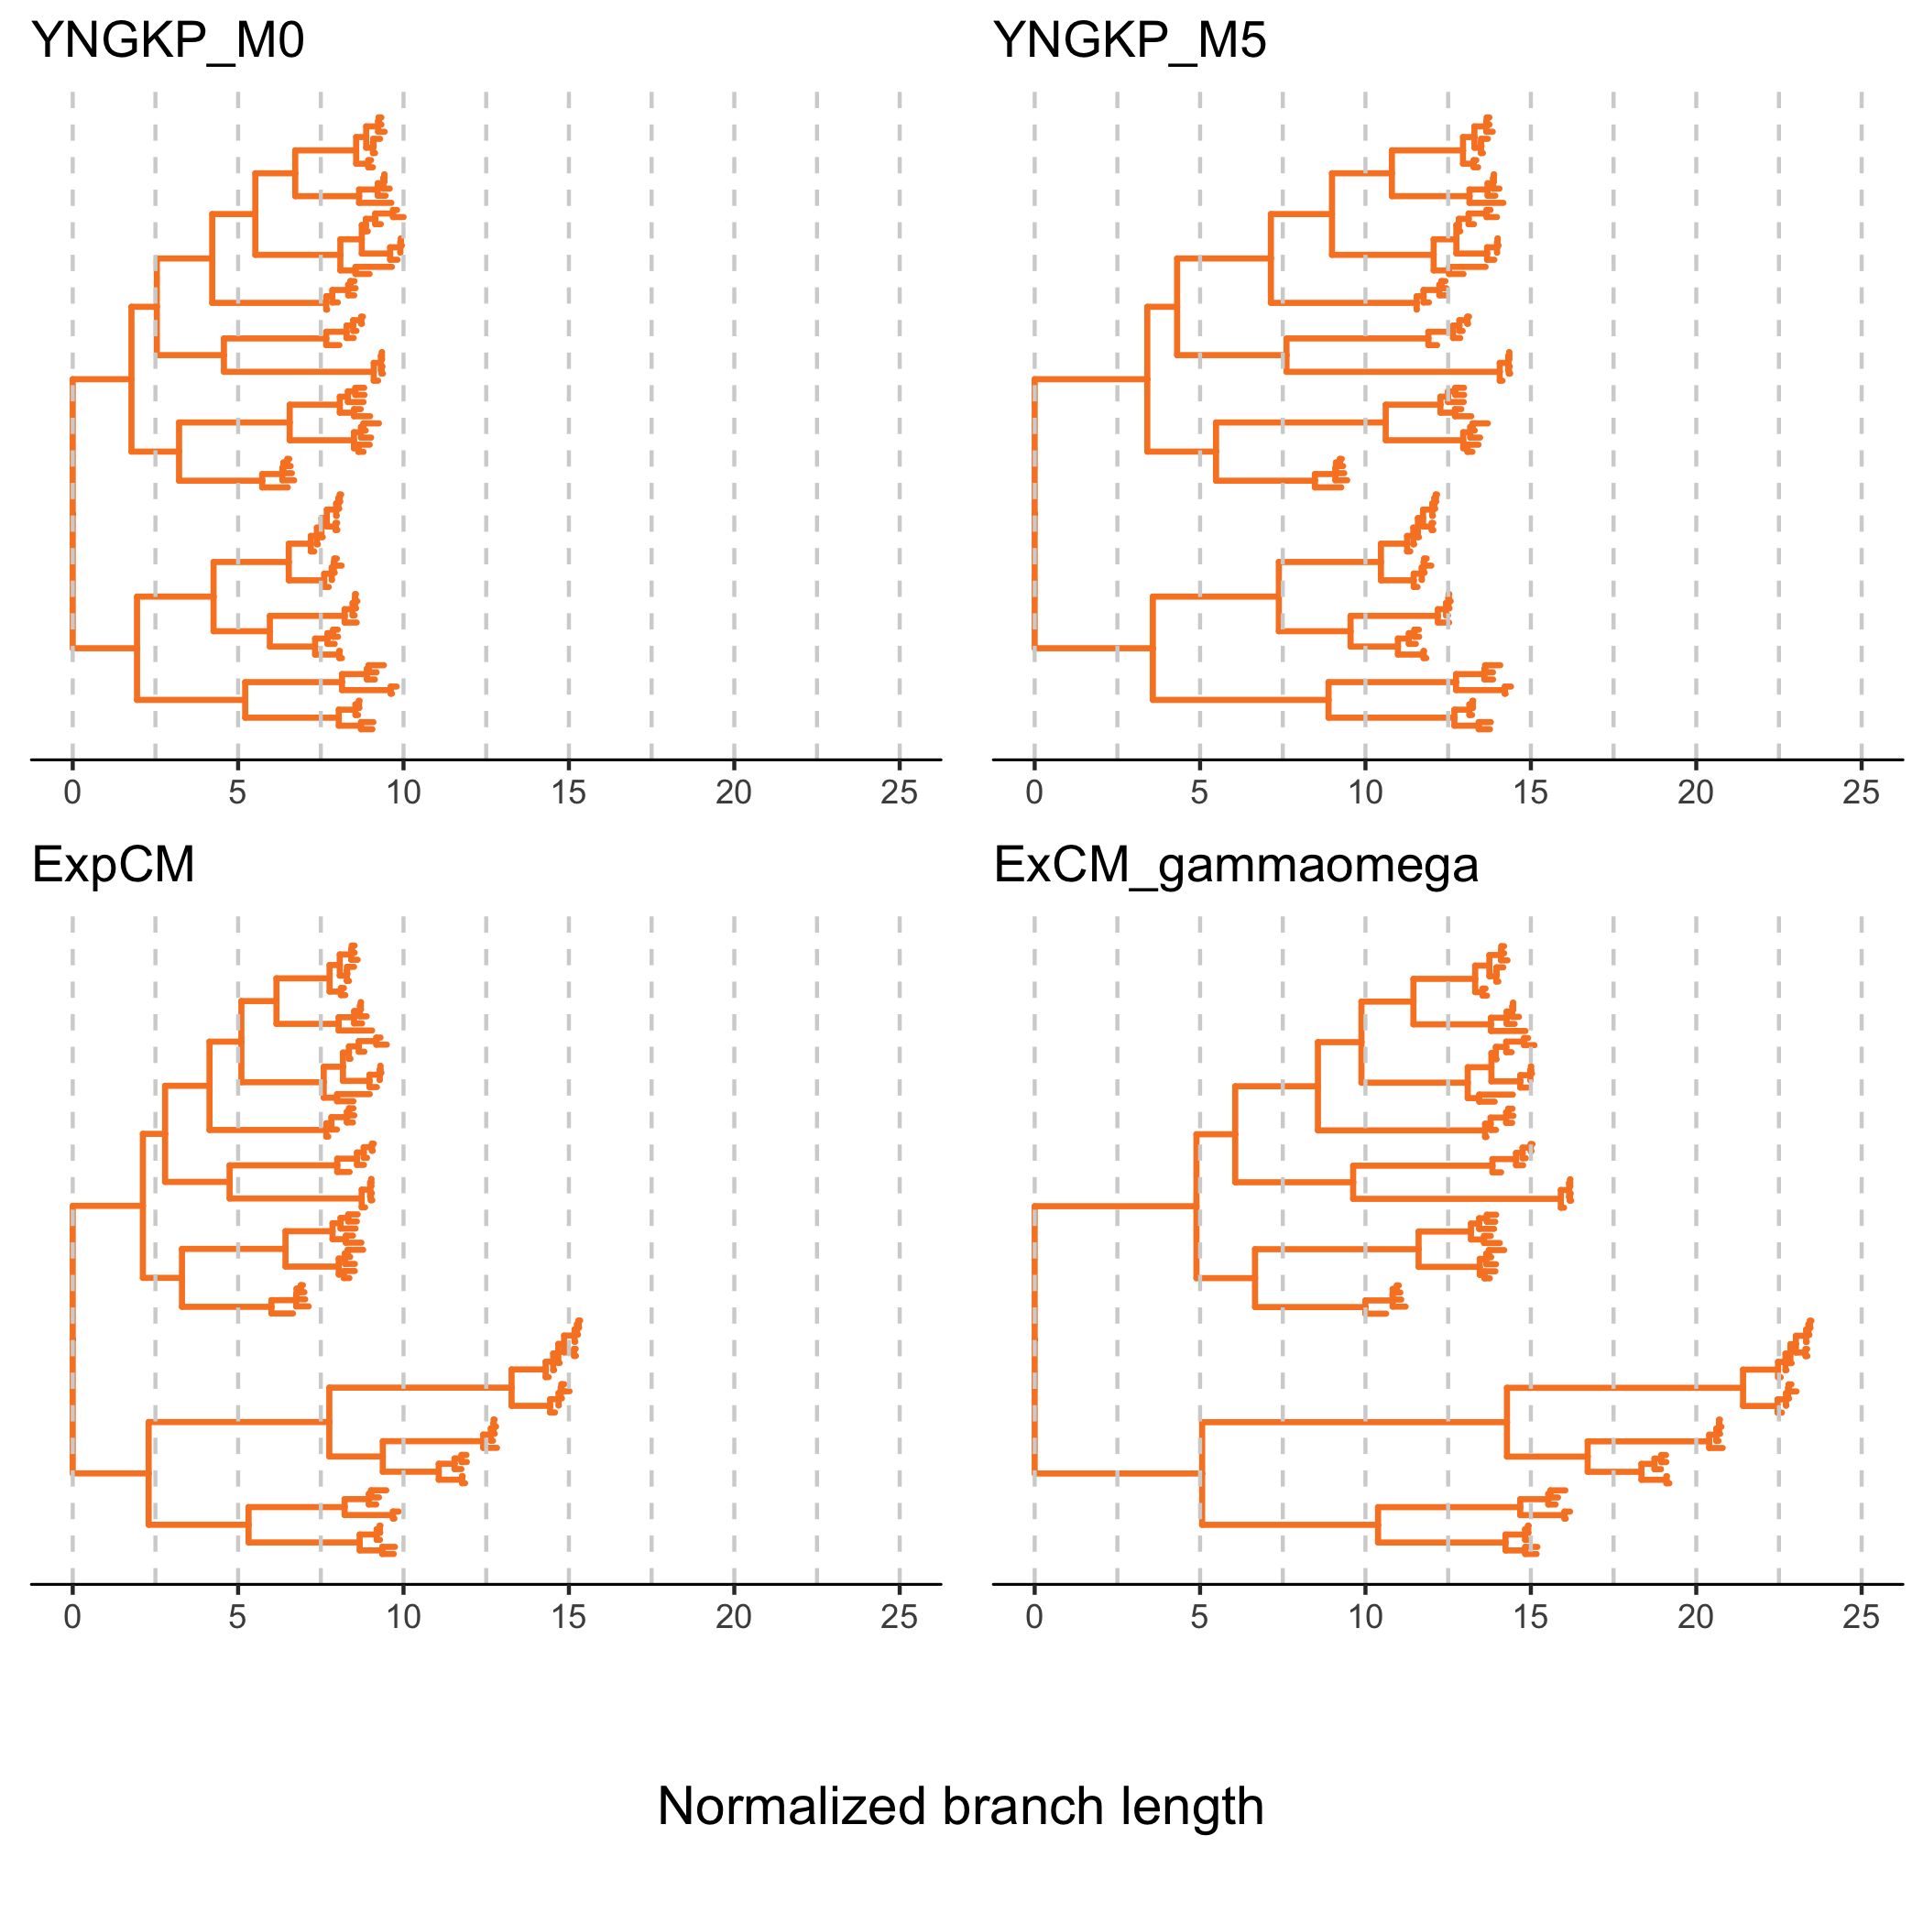
GY94
GY94 + $Γω$
ExpCM
ExpCM+$Γω$
Normalized branch length

Slide 15
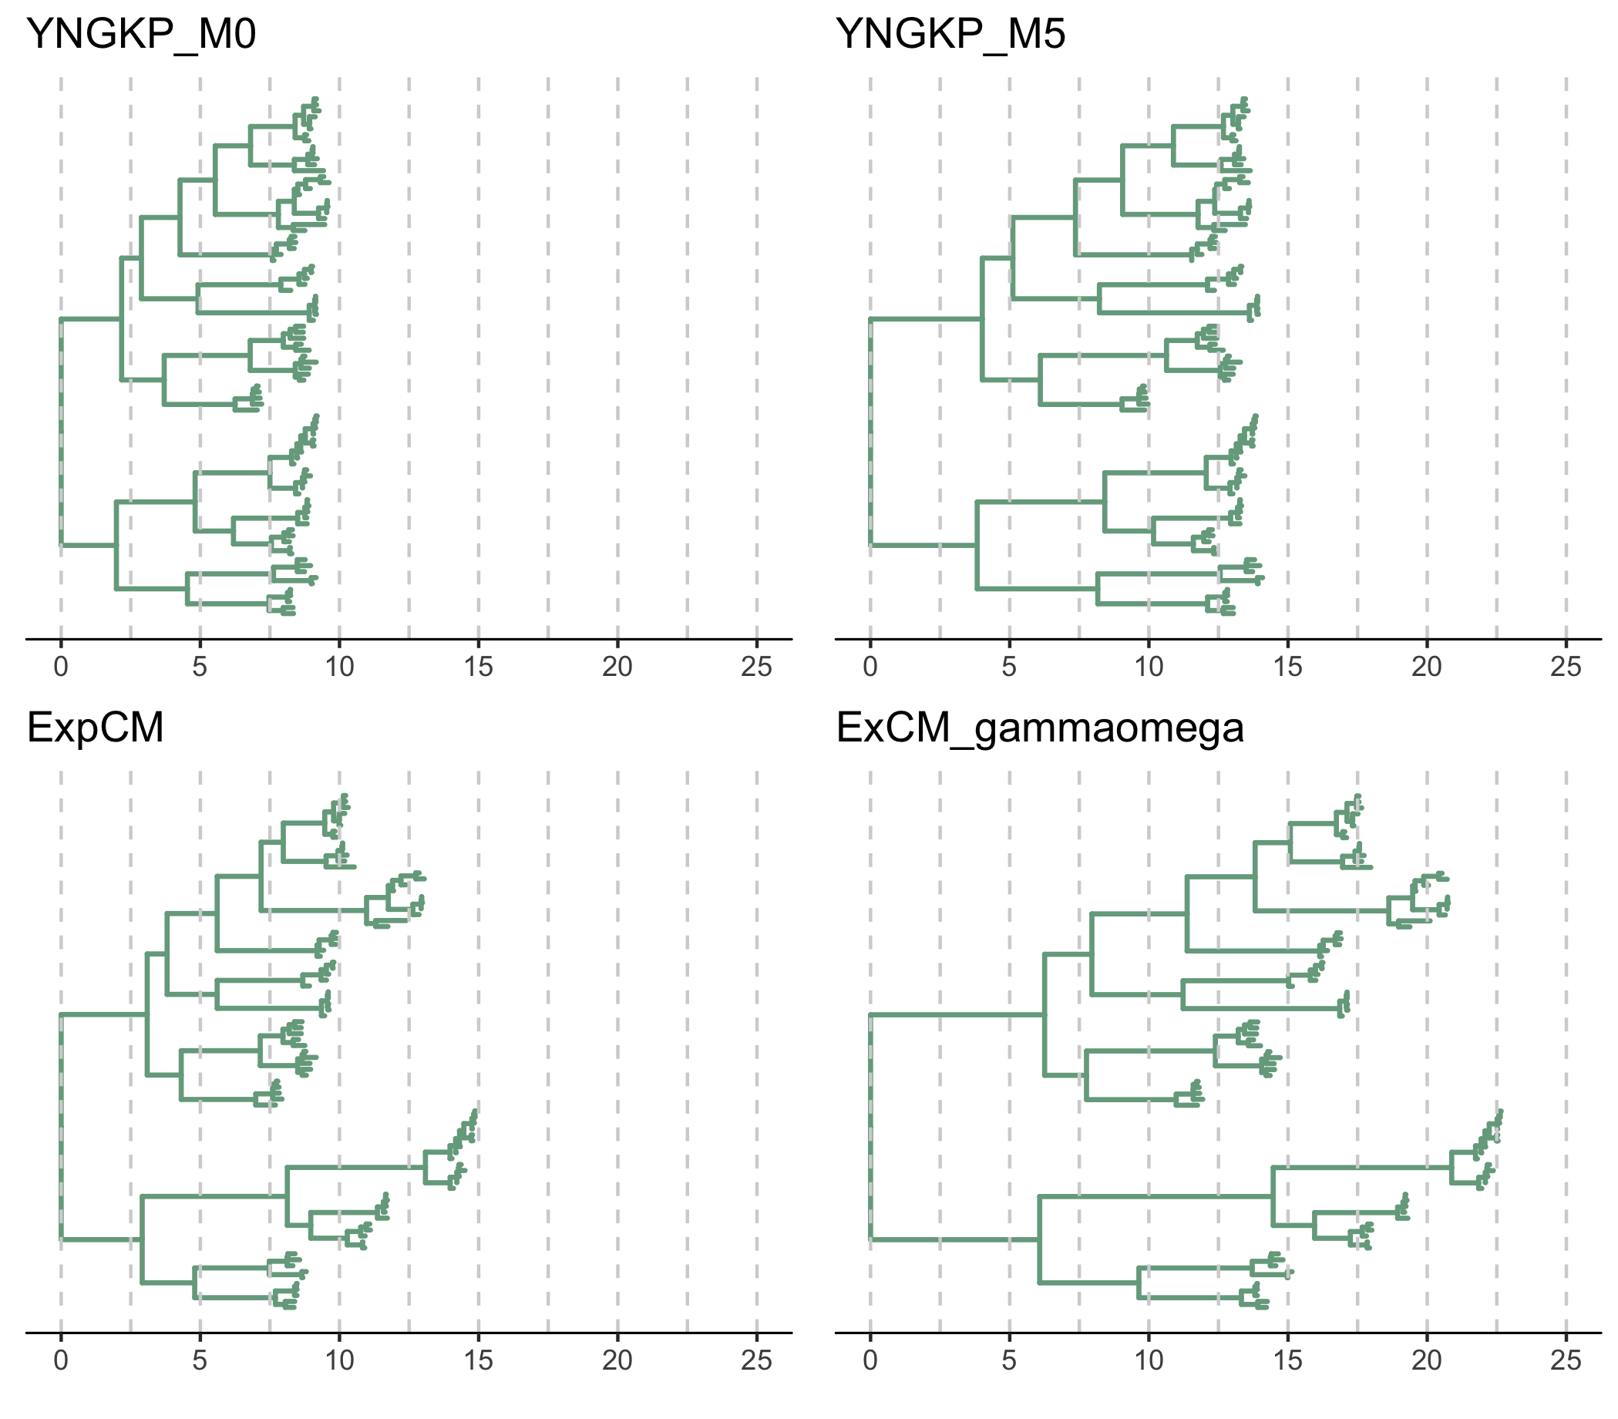
GY94
GY94 + $Γω$
ExpCM
ExpCM+$Γω$
Normalized branch length

Slide 16
SUPPLEMENTAL FIGURES

Slide 17
Preference Sets

Slide 18
Notes:
Doud, stringency 1.21

Slide 19
Notes:
Lee stringency 1.46

Slide 20
Notes:
Average, stringency 1.82

Slide 21
Full Experiments

Slide 22
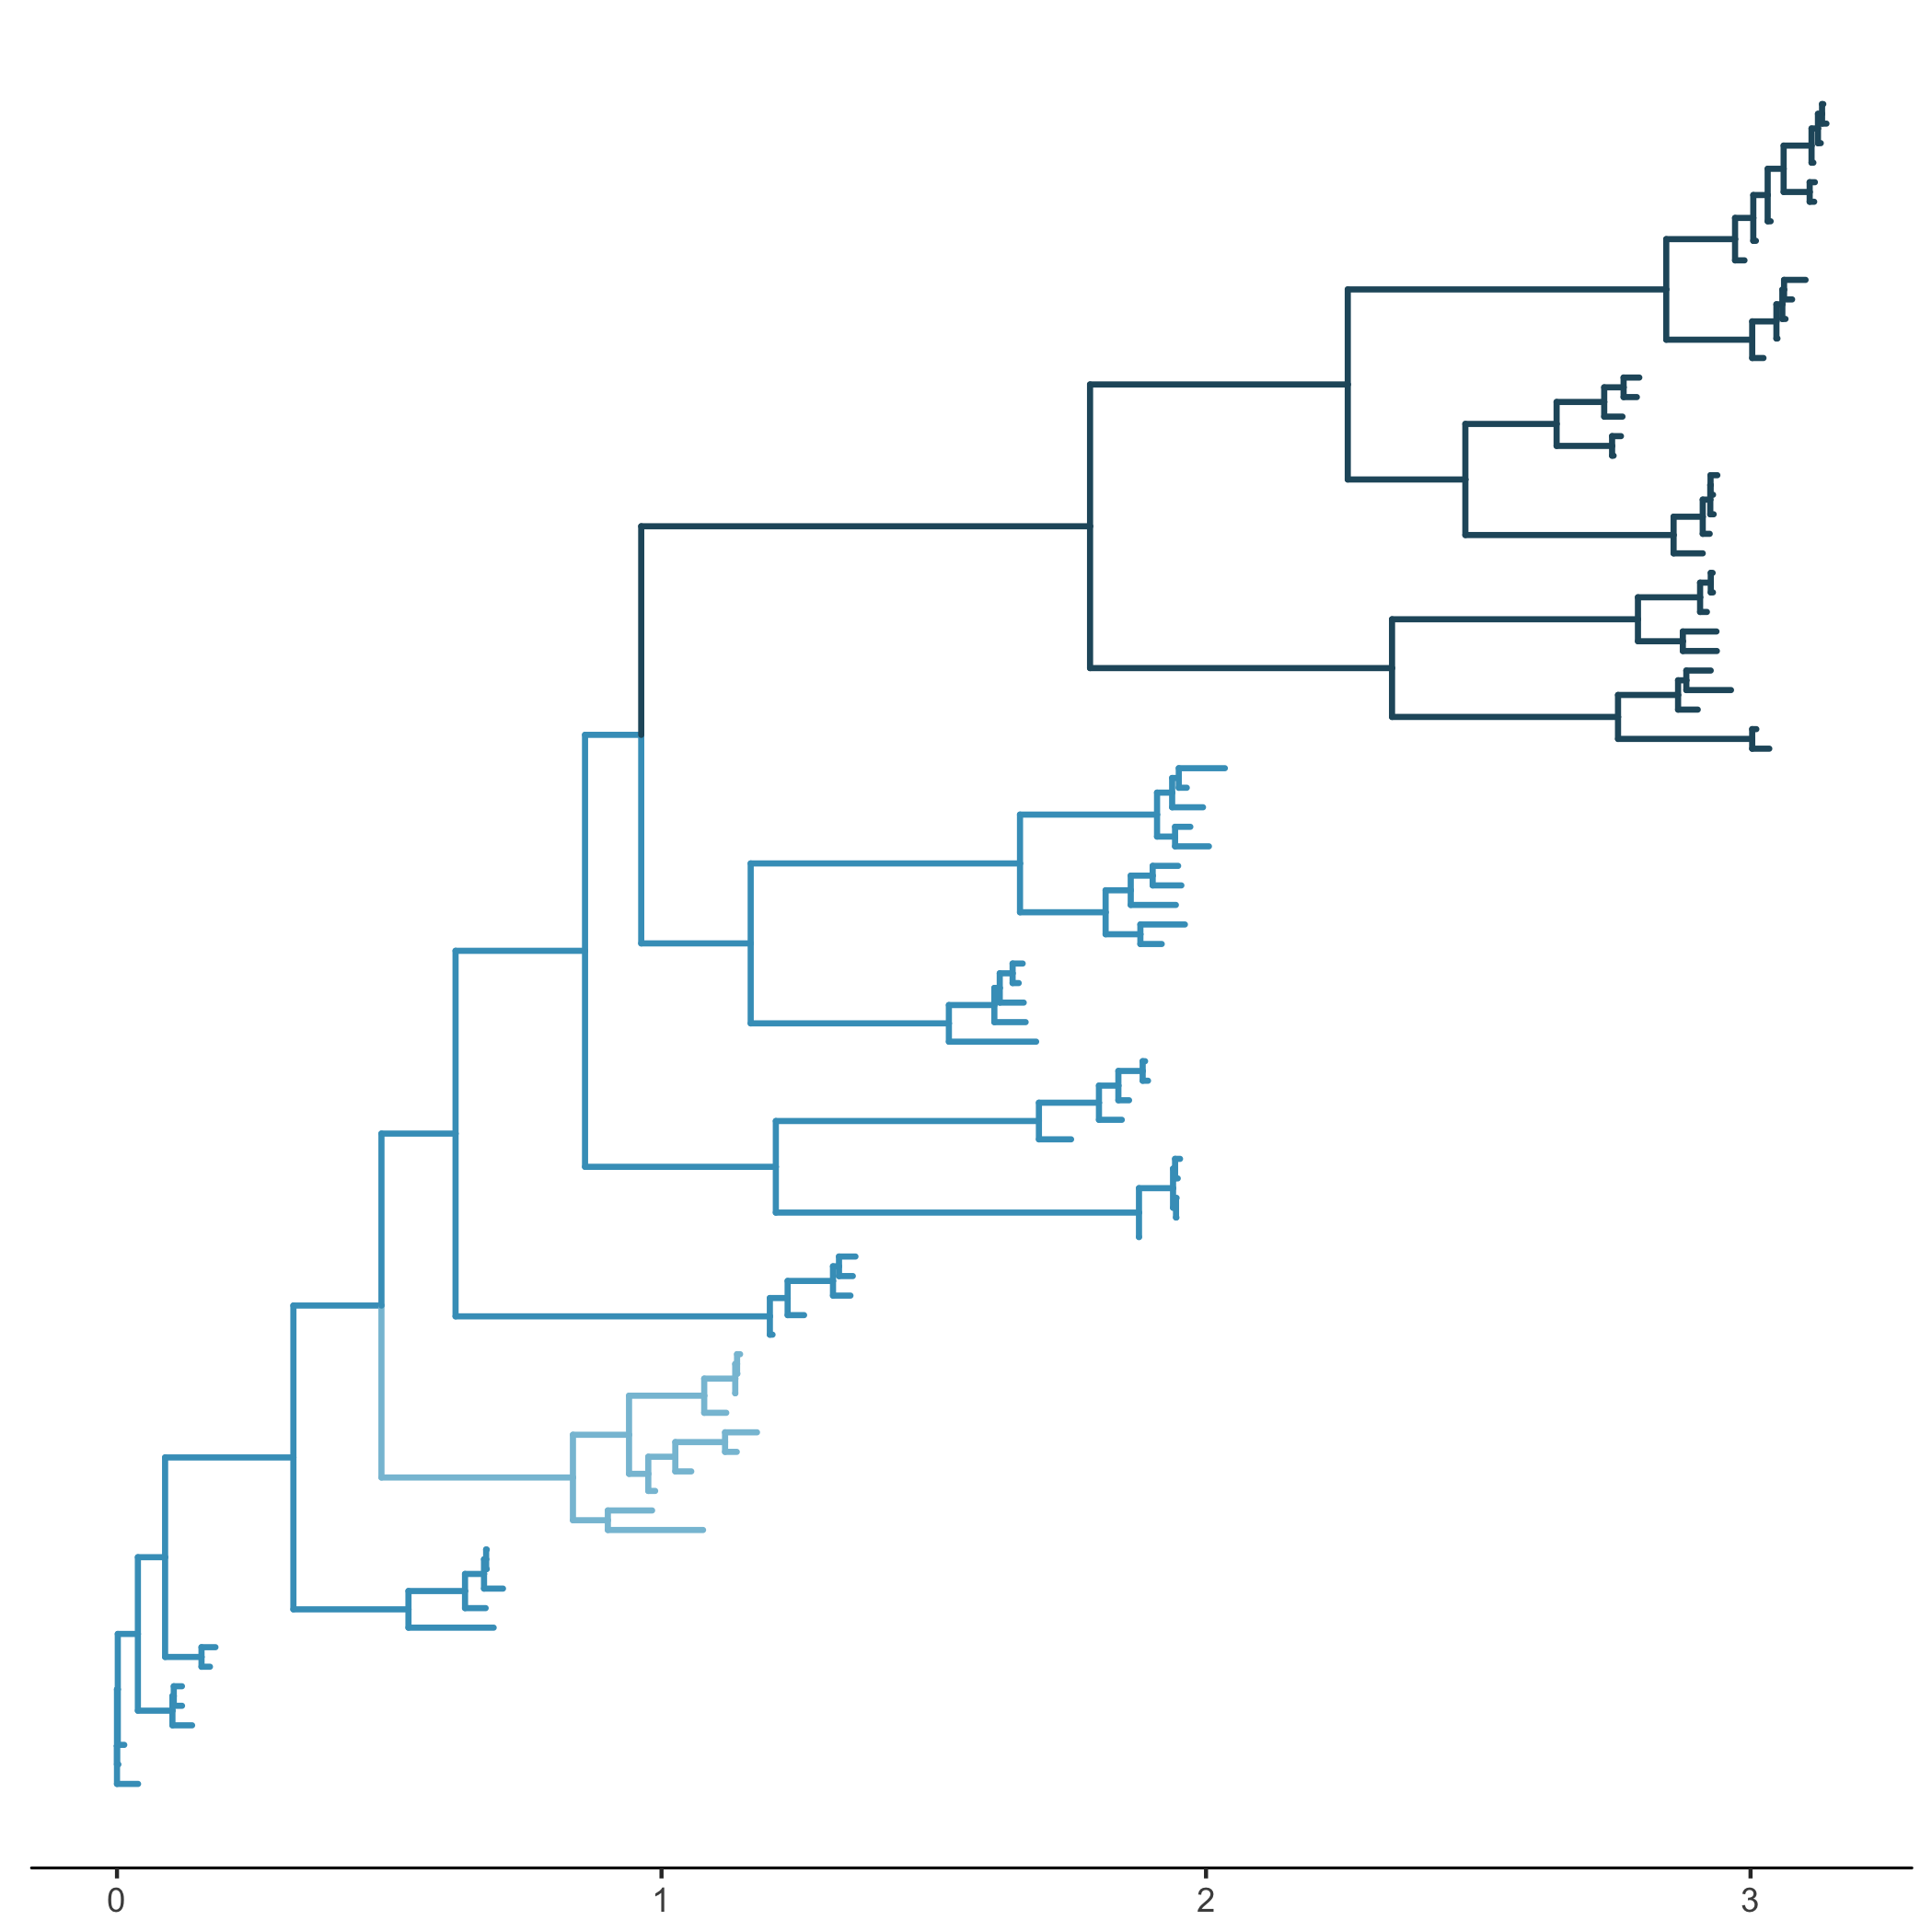
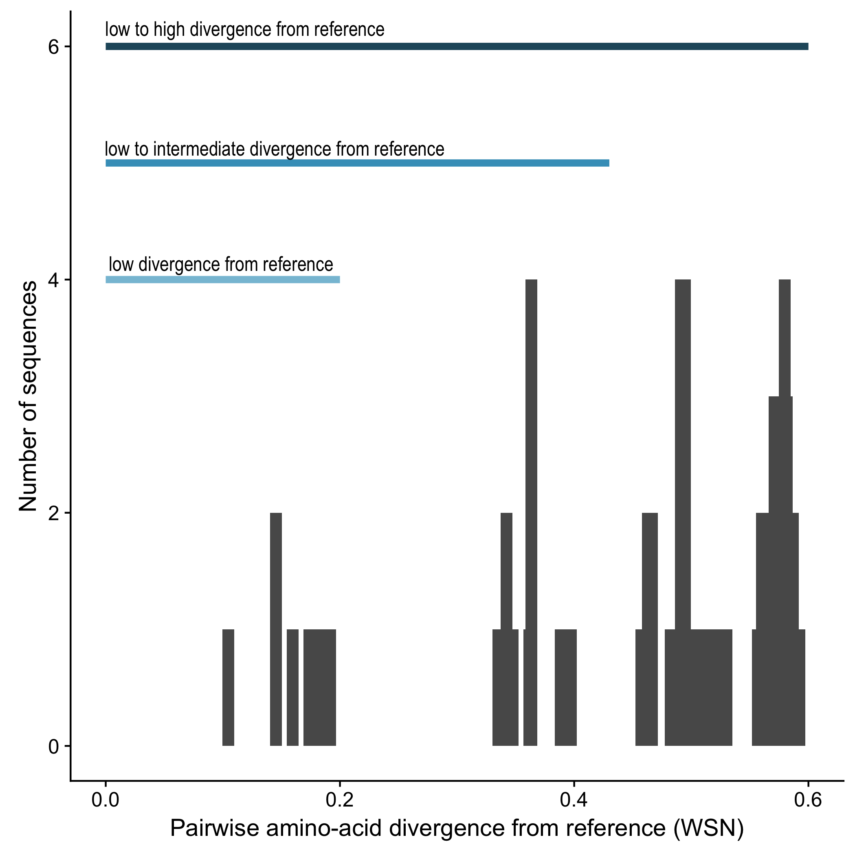
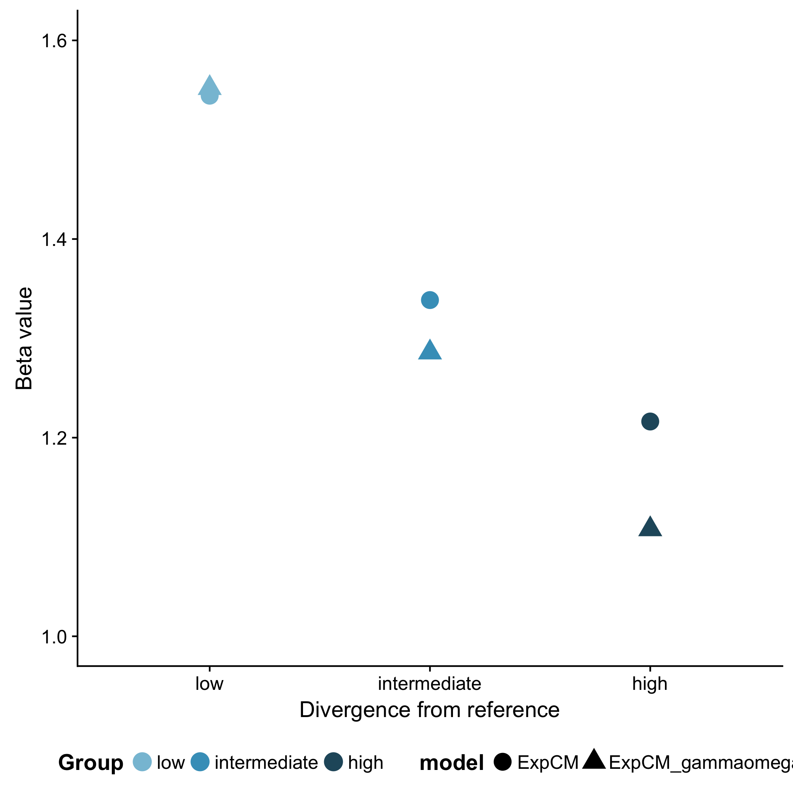
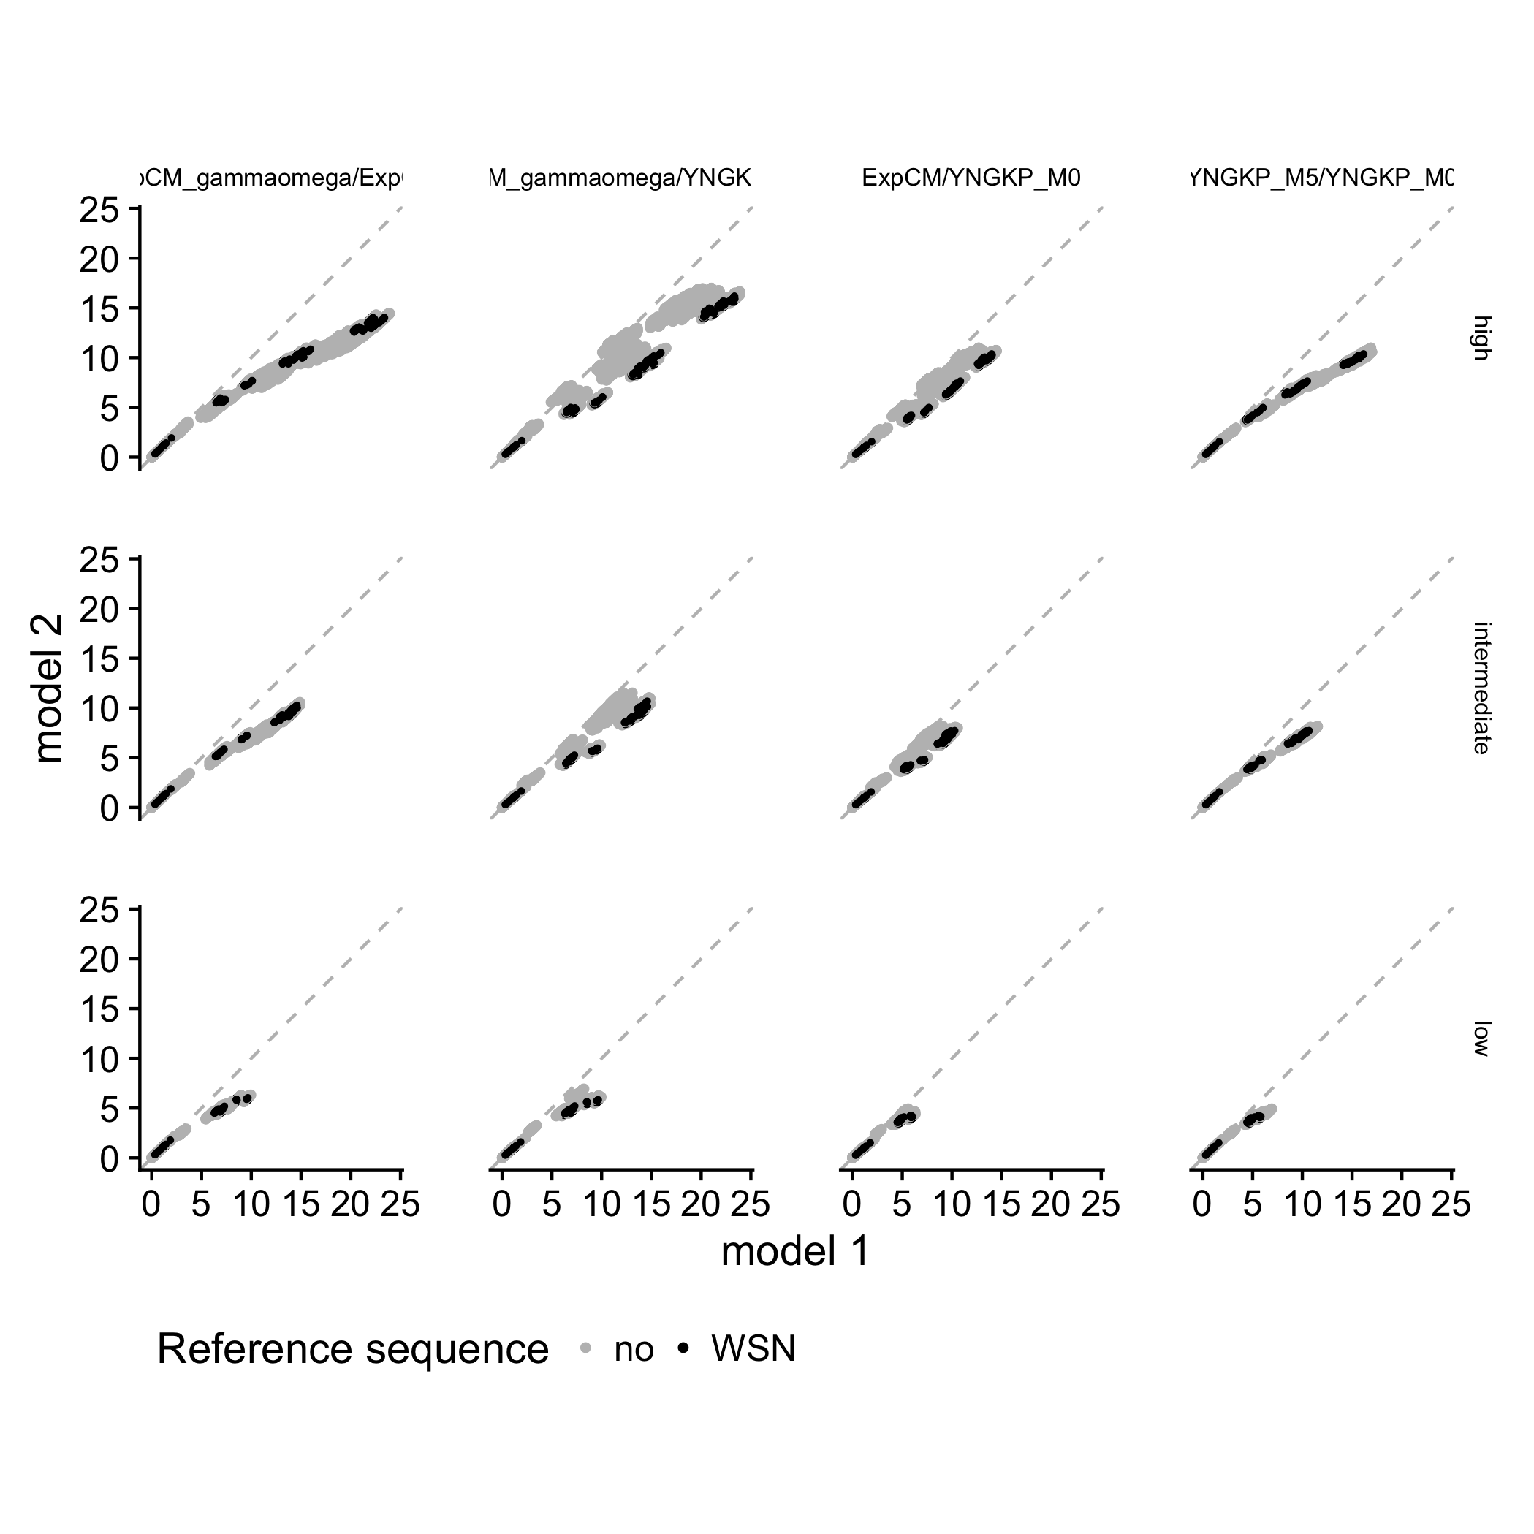
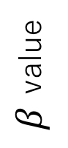
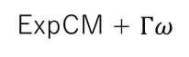
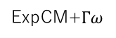
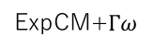
A
B
low to high divergence
low to intermediate divergence
low divergence
Number of sequences
Amino-acid divergence from focal sequence
Branch length
(average nucleotide substitutions per site)
C
D
Branch from focal sequence?
Yes
No
Model
ExpCM
ExpCM
YNKGP M5
YNKGP M0
YNKGP M0
high
ExpCM + $Γω$
Divergence level
$β$ value
ExpCM
YNKGP M5
YNKGP M0
YNKGP M0
intermediate
Branch length
ExpCM
YNKGP M5
YNKGP M0
YNKGP M0
low
ExpCM+$Γω$
ExpCM+$Γω$
ExpCM
YNGKP M5
Branch length
low
intermediate
high
Divergence from focal sequence

Slide 23
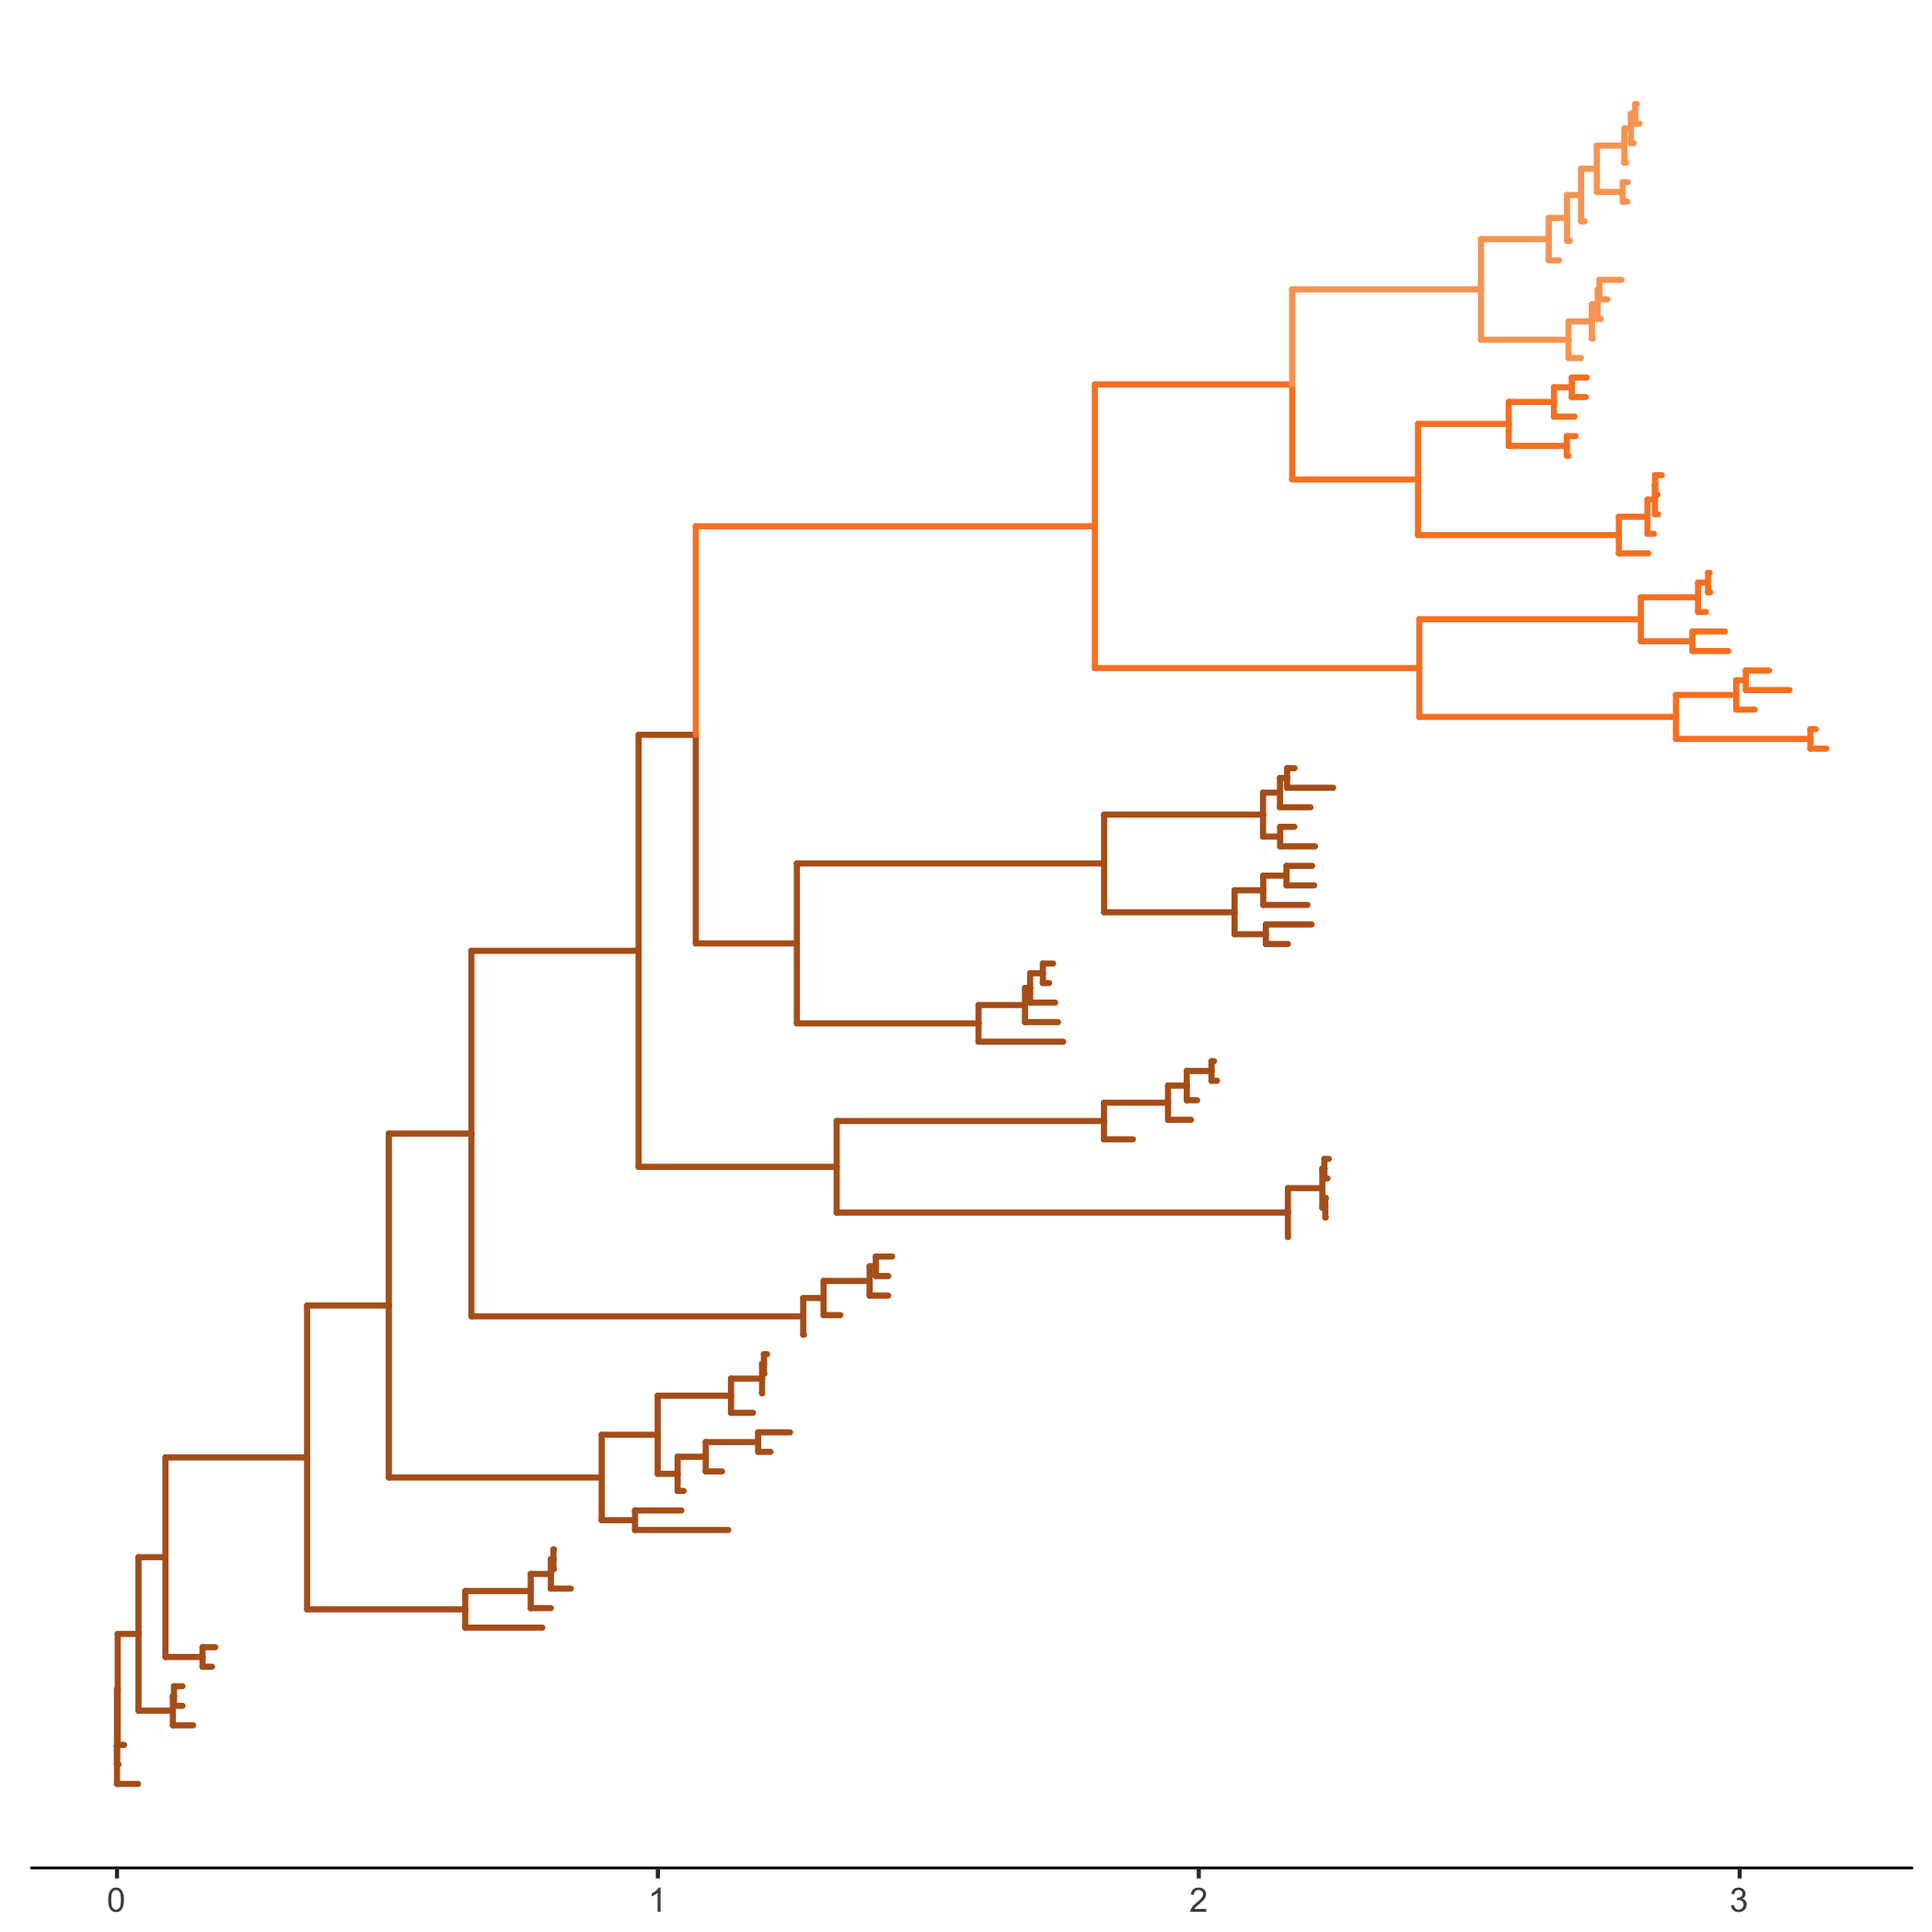
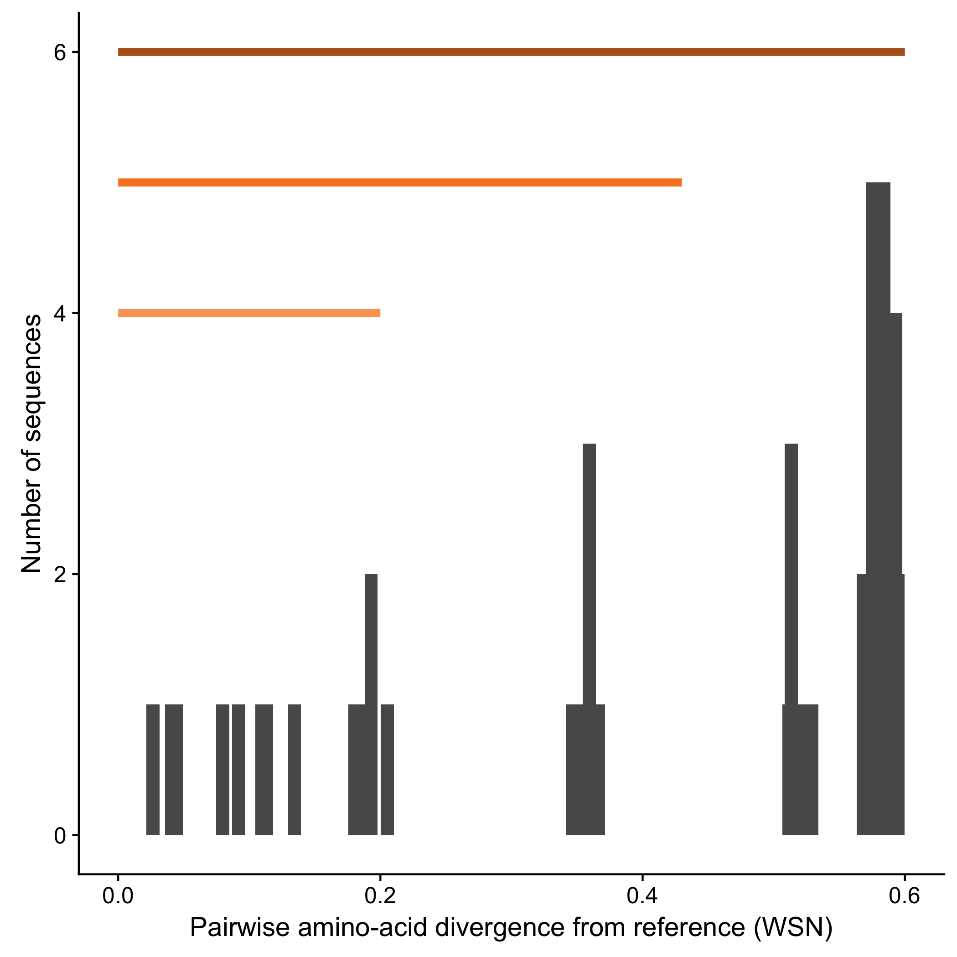
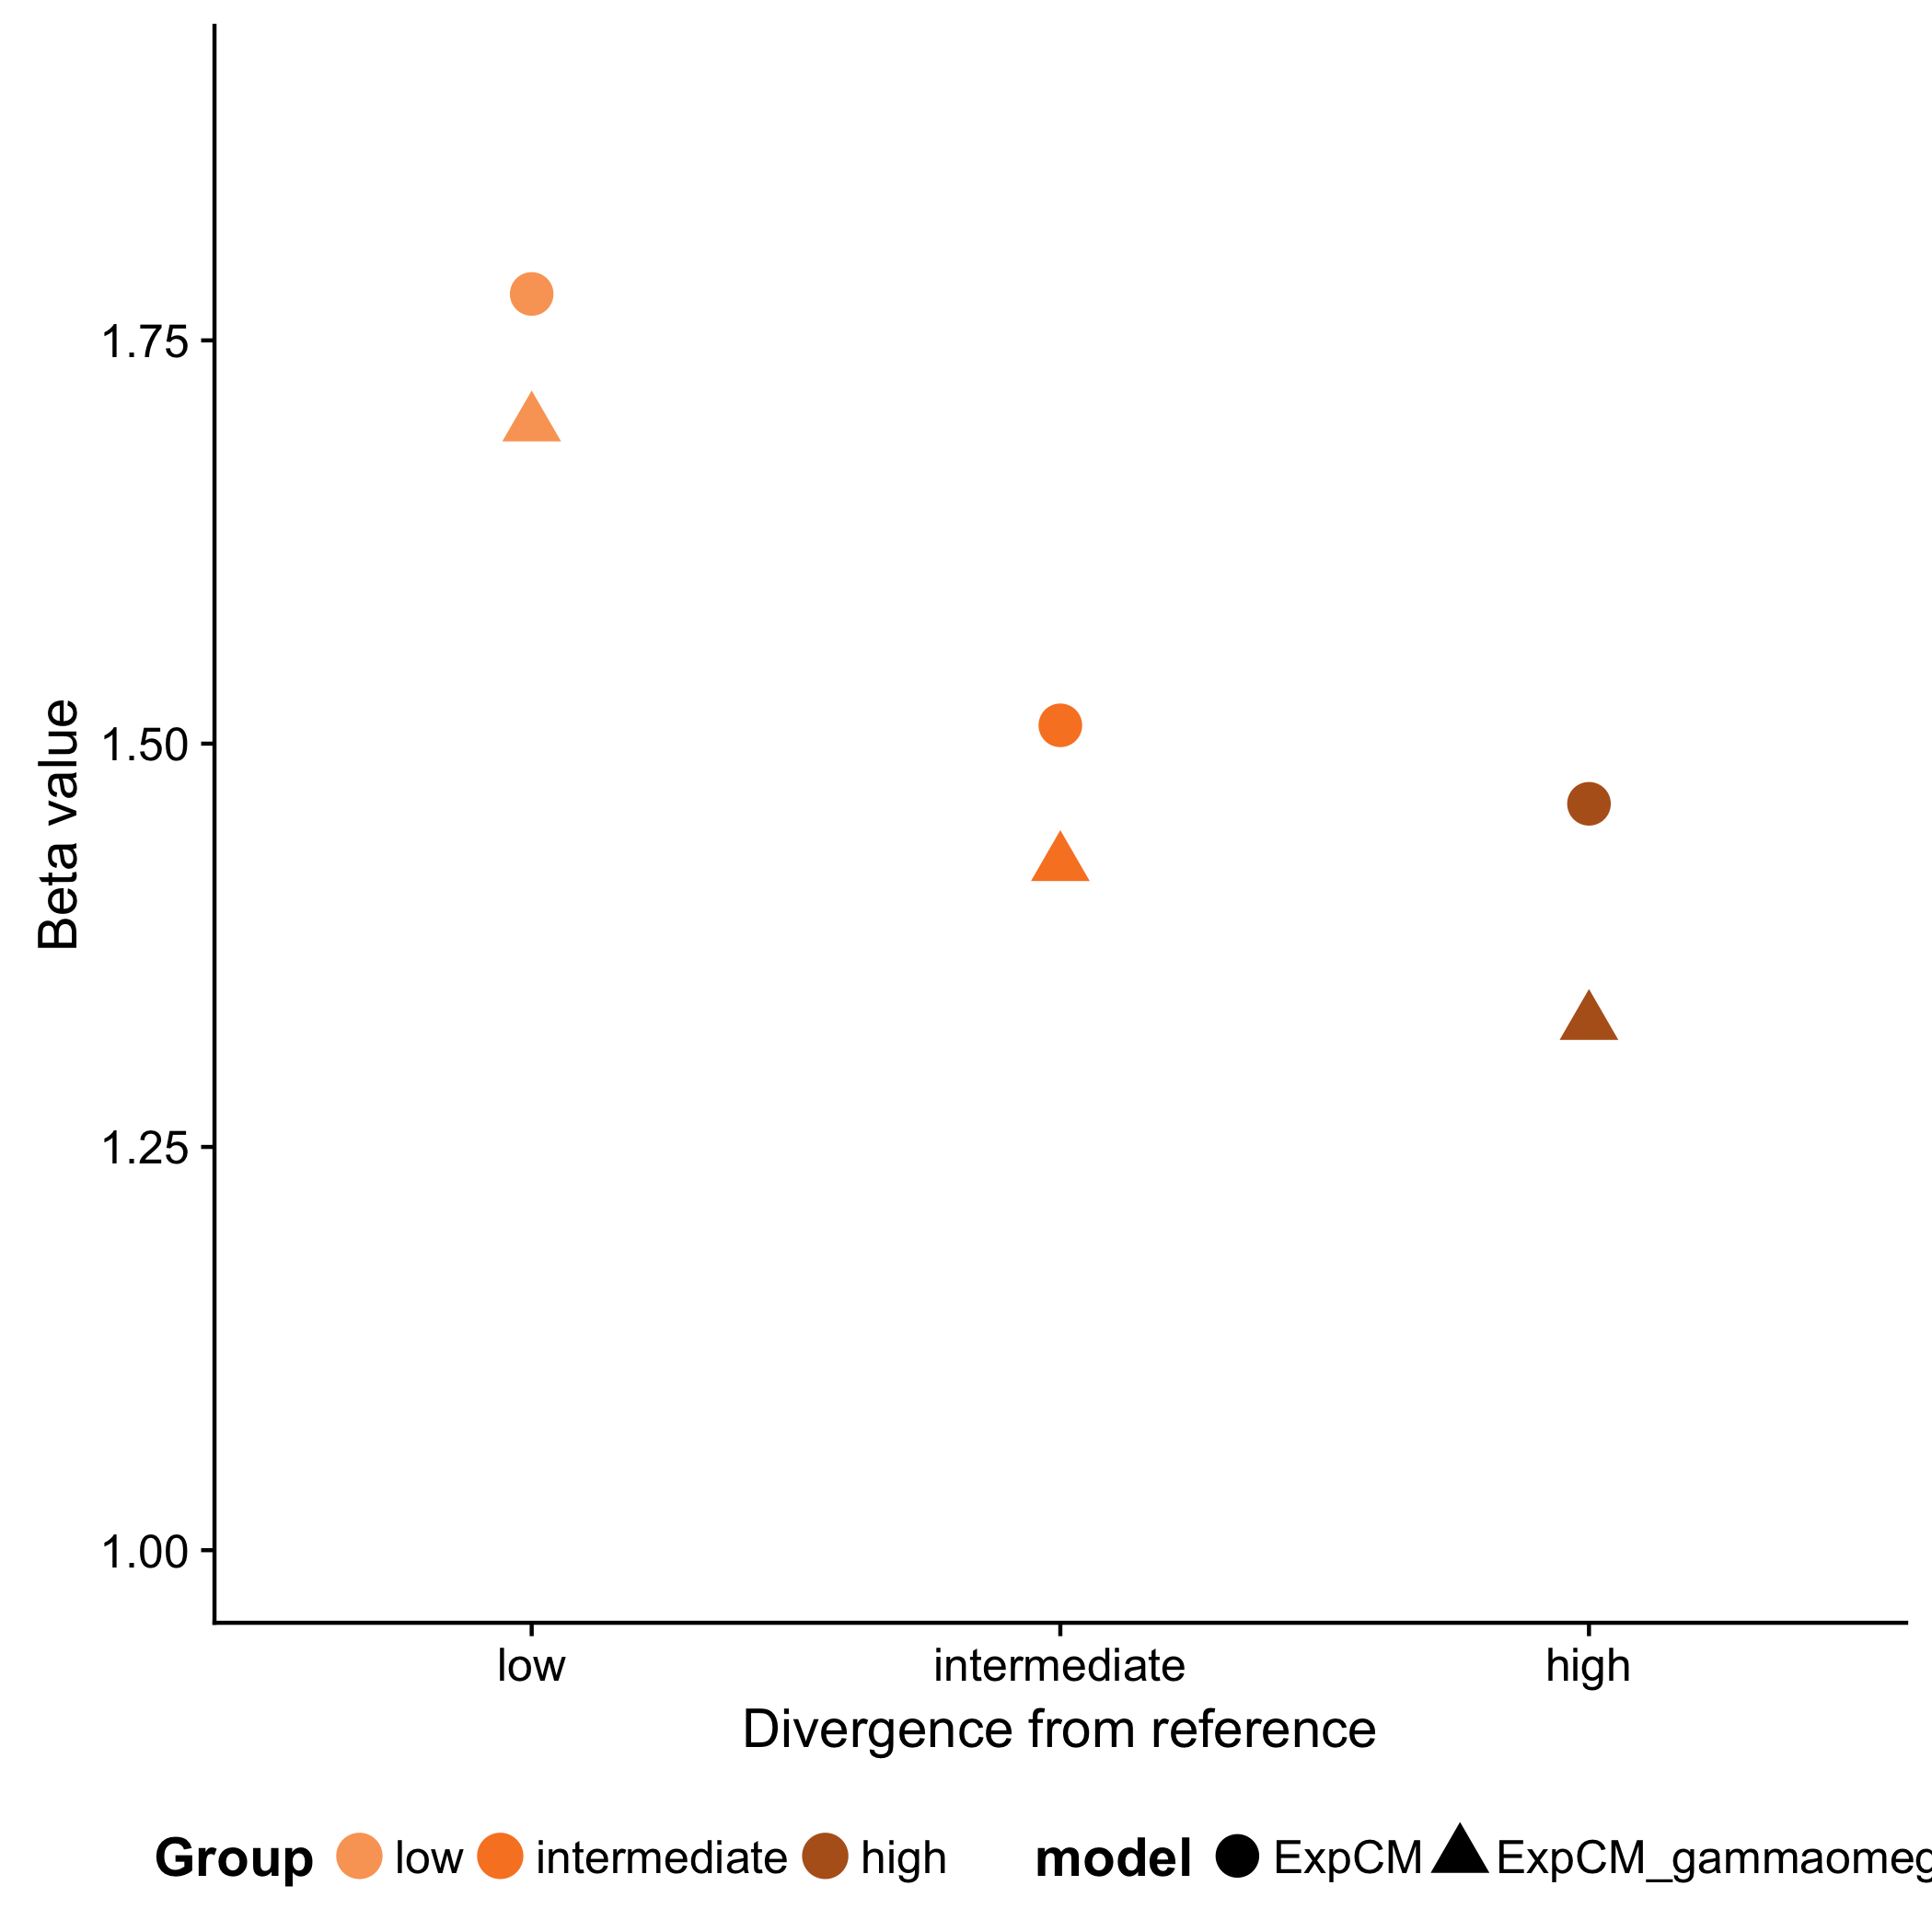
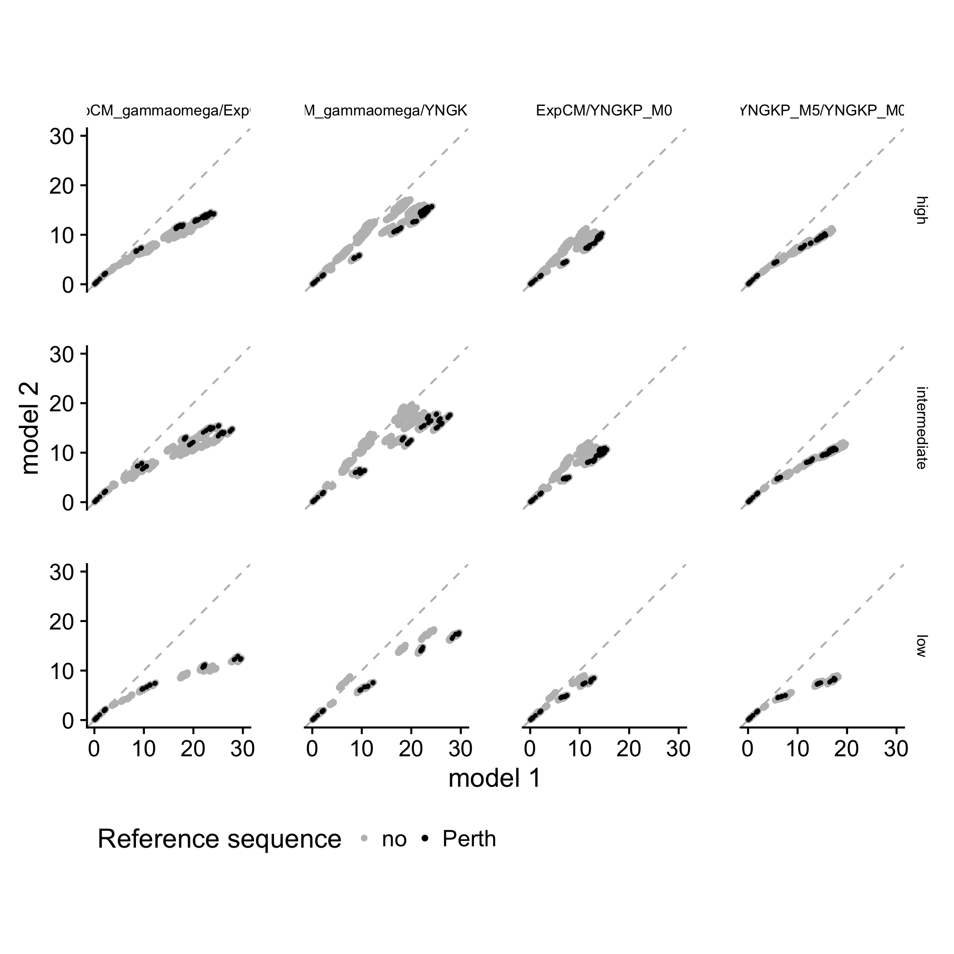
A
B
low to high divergence
low to intermediate divergence
low divergence
Number of sequences
Amino-acid divergence from focal sequence
Branch length
(average nucleotide substitutions per site)
C
D
Branch from focal sequence?
Yes
No
Model
ExpCM
ExpCM
YNKGP M5
YNKGP M0
YNKGP M0
high
ExpCM + $Γω$
Divergence level
$β$ value
ExpCM
YNKGP M5
YNKGP M0
YNKGP M0
intermediate
Branch length
ExpCM
YNKGP M5
YNKGP M0
YNKGP M0
low
ExpCM+$Γω$
ExpCM+$Γω$
ExpCM
YNGKP M5
Branch length
low
intermediate
high
Divergence from focal sequence

Slide 24
DMS schematic

Slide 25
A
B
C
D

Slide 26
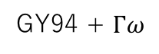
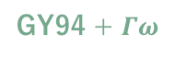

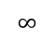
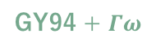


Time to identity
95%
75%
50%
0.00
0.50
1.75
ExpCM
0
100
0.00
0.25
1.75
GY94
Site 51
0.00
0.25
1.25
GY94 + $Γω$
GY94 + $Γω$
0.00
0.00
1.25
GY94 + $ω_{r}$
0.25
5.75
74.75
ExpCM
0.00
0.25
1.75
GY94
Site 23
0.00
0.00
2.50
GY94 + $Γω$
0.00
0.50
1.25
GY94 + $ω_{r}$
0.25
10.5
$$∞$$
ExpCM
0.00
0.25
1.75
GY94
Site 490
0.00
0.00
2.50
GY94 + $Γω$
0.00
0.50
2.74
GY94 + $ω_{r}$

